Slide 1
An EMF Framework for Event-B
Developed by:
Colin Snook – University of Southampton,
Fabian Fritz – Heinrich Heine University, Düsseldorf,
Alexei Illiasov – Newcastle University
Deploy
Integrated Project IST 214158
Industrial deployment of advanced system engineering methods for high productivity and dependability
www.deploy-project.eu

Slide 2
EMF
Eclipse Modelling Framework (Ed Merks et al.)
Meta-modelling notation (abstract syntax)
Code Generator
Model repository (database)
Edit support (providers)
Runtime Support for building tools:
Command framework, Persistence, Dynamic (programmatic) EMF
Lots of related technologies
Compare/merge, M2M, M2Text

Slide 3
Rodin platform for Event-B
Eclipse
UI
Rodin Database
Event-B
Rodin Database
API
*.bum, *.buc, …
Marker
StaticChecker
Event-B
static checked
*.bcm, *.bcc, …
Prover

Slide 4
Motivation for Event-B EMF
UML-B – reimplementation to give tighter integration
Text editor
Teamworking – EMF Compare/Merge
Model transformations
Code generation

Slide 5
Front-End Approach
EMF front-end for Event-B
Other EMF based models
(e.g. UML, Epsilon based)
Text Editor
Teamwork
UML-B
translator
Marker
Persistence
Event-B IDE
(static checker, prover)
API
Rodin Database
*.bum, *.buc, …
Notes:
What does this give us?
Still using Rodin DB for serialisation
But have an alternative EMF in-memory representation of models when loaded

Slide 6
Event-B Metamodel
Core package
Abstract basis
Extension mechanism
Project
Machine package
Context package
http://wiki.event-b.org/index.php/EMF_framework_for_Event-B

Slide 7
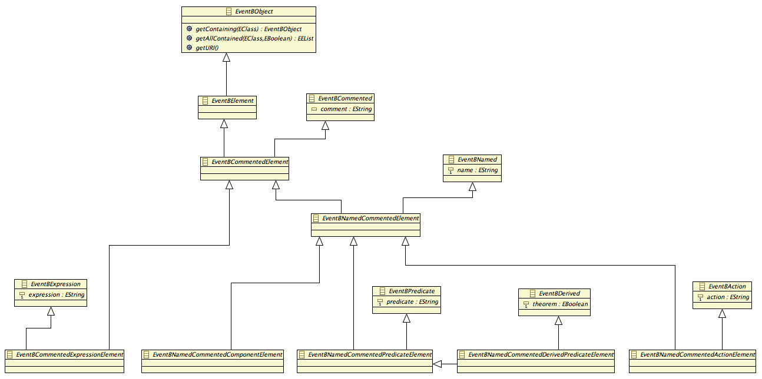
Abstract Core

Slide 8
Abstract Core
Loads of Inheritence!
Allows generic code
(like rodinDB does)
Notes:
Hierarchy of abstract objects building up common attributes to allow generic processing code – e.g. process all named, commented elements x instanceof EventBNamedCommentedElement
Can’t always adhere to a tree – so tend to add attributes by inheriting a metaclass. – e.g. process all named elements – if ( x instanceof EventBNamed) String name = ((EventBNamed)x).getName();

Slide 9
Abstract Core

Slide 10
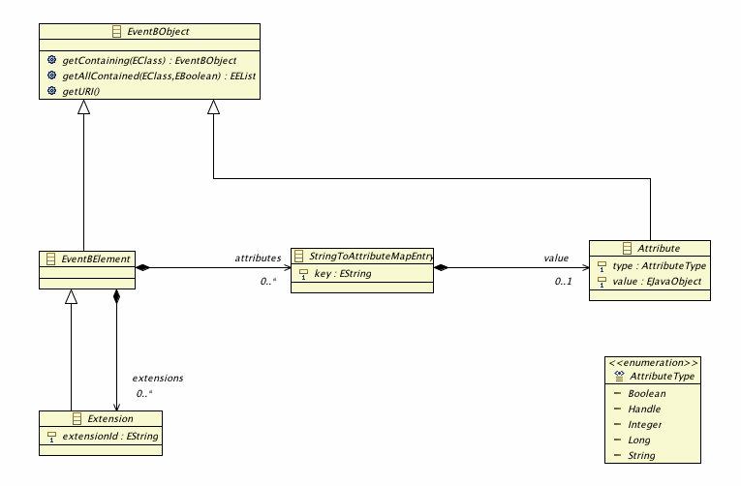
Extension Mechanism
EMF map facility:
Attributes can be retrieved by key
(key = rodin attribute ID)
Attribute types reflect Rodin
Abstract
(e.g. Camille Text : String)
Notes:
All ‘elements’ inherit two collections for extensions
Attributes – this metamodel format recognised by EMF – generates a map
Used to load/store unrecognised Rodin attributes that aren’t handled explicitly by the persistence
key = rodin attribute id
can also be used to store volatile attributes - leave key blank
Extensions:
new elements can be contributed and added to an elements extensions contribution
contribute a synchroniser to define how to persist the new element kind
Limitation – cannot control the parent of the new element – potentially can be added to any element
[N.B – currently looking at mechanism to control parent via a metaclass EAnnotation.
Also the possibility to make the extension an extension of its parent so that new containments can be added]
EMF metamodels can refer to each other
subtype an existing element to add to an existing collection
(e.g. add a new component type by subtyping EventBNamedCommentedComponent)
Or
subtype EventBElement and add instances to any element’s extensions collection
add attribute maps to any elements attributes mapping

Slide 11
Extension Mechanism
Any element can be given new children by subtyping AbstractExtension.
Abstract
Notes:
All ‘elements’ inherit two collections for extensions
Attributes – this metamodel format recognised by EMF – generates a map
Used to load/store unrecognised Rodin attributes that aren’t handled explicitly by the persistence
key = rodin attribute id
can also be used to store volatile attributes - leave key blank
Extensions:
new elements can be contributed and added to an elements extensions contribution
contribute a synchroniser to define how to persist the new element kind
Limitation – cannot control the parent of the new element – potentially can be added to any element
[N.B – currently looking at mechanism to control parent via a metaclass EAnnotation.
Also the possibility to make the extension an extension of its parent so that new containments can be added]
EMF metamodels can refer to each other
subtype an existing element to add to an existing collection
(e.g. add a new component type by subtyping EventBNamedCommentedComponent)
Or
subtype EventBElement and add instances to any element’s extensions collection
add attribute maps to any elements attributes mapping

Slide 12
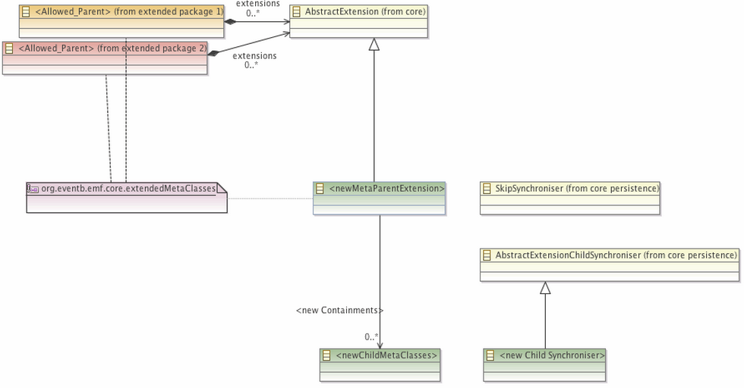
Extension Mechanism - restricting new children’s parents
Modified JET code templates adjust child providers if this annotation is present
Notes:
All ‘elements’ inherit two collections for extensions
Attributes – this metamodel format recognised by EMF – generates a map
Used to load/store unrecognised Rodin attributes that aren’t handled explicitly by the persistence
key = rodin attribute id
can also be used to store volatile attributes - leave key blank
Extensions:
new elements can be contributed and added to an elements extensions contribution
contribute a synchroniser to define how to persist the new element kind
Limitation – cannot control the parent of the new element – potentially can be added to any element
[N.B – currently looking at mechanism to control parent via a metaclass EAnnotation.
Also the possibility to make the extension an extension of its parent so that new containments can be added]
EMF metamodels can refer to each other
subtype an existing element to add to an existing collection
(e.g. add a new component type by subtyping EventBNamedCommentedComponent)
Or
subtype EventBElement and add instances to any element’s extensions collection
add attribute maps to any elements attributes mapping

Slide 13
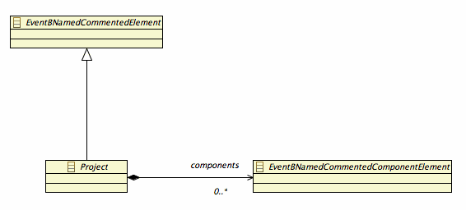
Project
All concrete classes inherit
from an abstract one

Slide 14
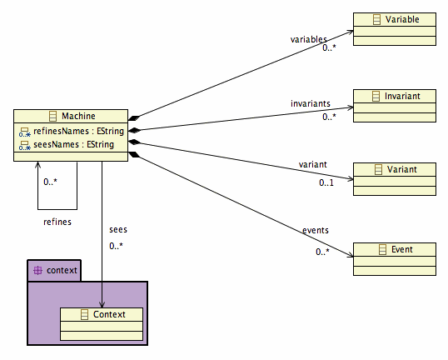
Machine

Slide 15
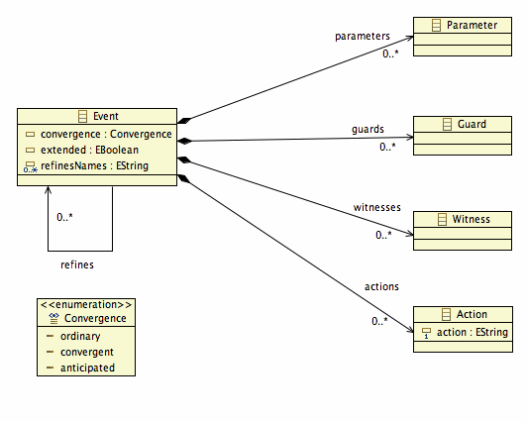
Event

Slide 16
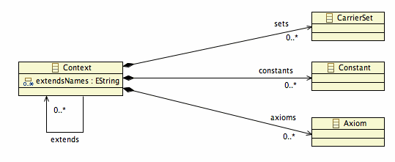
Context

Slide 17
Inter-Resource References
Refines Machine, Refines Event, Sees Context
Some tools work on multiple resources
Need direct model references
EMF proxy facilities for resolving/loading when needed
Some tools work on a single resource
Don’t want to load referenced resources
Leave proxies unresolved
Often they are un-resolvable (i.e. do not exist)

Slide 18
Solution – Dual Representation
List of References (EMF proxies)
Use Lazy proxy construction
URI fragment = reference name (persisted)
When resolve attempted….
… Automatically construct rest of URI …
Project/resource from containing component
List of Names
Transient (no storage)
Derived from proxy fragments (by getter)
Can be edited .. Notifies parent …
.. Proxy fragments kept in step (even if not resolvable)

Slide 19
Machine

Slide 20
Persistence
Overrides EMF’s default XMI persistence
Load and Save into Rodin DB via API
Synchronisers for each element type
Registered via extension point
Allows for new elements to be defined by plugins
Volatile extensions (no synchroniser)
Attributes
Can be Dealt with explicitly in Synchroniser… or
Left to Generic Attribute handler
Nothing is lost

Slide 21
Persistence – to XMI
May wish to store components outside of Rodin DB
Option to load/save using EMF’s XMI serialisation
E.g. copy in SVN for teamworking

Slide 22
A Framework for Diagrammatic Modelling Extensions in Rodin
Developed by:
Colin Snook and Vitaly Savicks – University of Southampton,

Slide 23
Extending Event-B (1)
EMF Event-B Core
New Extension
EMF
Event-B Core
Rodin DB
Rodin Platform

Slide 24
Extending Event-B (2)
EMF Event-B Core
New Extension
EMF
Event-B Core
EMF Translation
Rodin Platform
Persistence as String

Slide 25
Refinement Participant
(My New Extension)
New Refinement Participant
Defines how to handle references
(EMF Event-B Core Extension)
Abstract Extension Refiner
Provides generic deep clone of abstract mode
inherits
extension
pt.
References
1) Vertical - reference to corresponding abstract element (e.g. refines)
2) Horizontal - reference cloned within new refined model
(Rodin Platform)
Extensible Refinement Tool

Slide 26
A Framework for Diagrammatic Modelling Extensions in Rodin
Developed by:
Colin Snook and Vitaly Savicks – University of Southampton,

Slide 27
Now we want Diagrams!
EMF Event-B Core
Diagram Extension
EMF
Diagram
DiagramOwner
*
diagrams

Slide 28
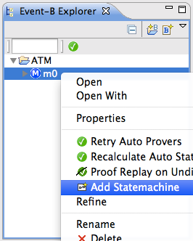
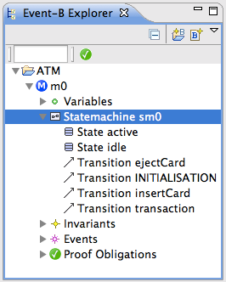
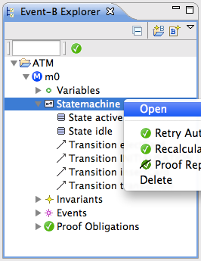
Contributes to Event-B Navigator
Diagram Extension
Or double click to open
EMF Event-B Core Extension

Slide 29
Translation to Event-B
(My Diagram Extension)
Declare Generator for My Diagram
Offer these Generator Rules
command handler extension point
(Diagram Extension Framework)
Configurable Event-B Generator
rule extension point
(source element type, rule class)
Rule Class - methods:
enabled? for this source element?
dependencies ok? - defer until later
fire - return list of descriptors for generating new elements (avoid rollback)

Slide 30
Diagram Copier - Refinement Participant
Model is already refined by the previous Refinement Participant
But diagram layout is lost
Diagram Copier Refinement participant
Finds all the diagram layout files relevant to a Machine/Context
Copies them,
Updates their file name for the new machine/context
Updates references within them to the corresponding refined elements

Slide 31
End

